Slide 1

Welcome to my presentation

Slide 2

Daffodil International University
Name: Masifa Tabassum Prottasha
Id: 221-24-037
Department of Journalism Media & Communication

Slide 3

What is Social media?
Social media is a collective term for websites and applications that focus on communication, community-based input, interaction, content-sharing and collaboration. People use social media to stay in touch and interact with friends, family and various communities.

Slide 4

When was social media invented?
In 1987, the direct precursor to today's internet came into being when the National Science Foundation launched a more robust, nationwide digital network known as the NSFNET. A decade later, in 1997, the first true social media platform was launched.

Slide 5
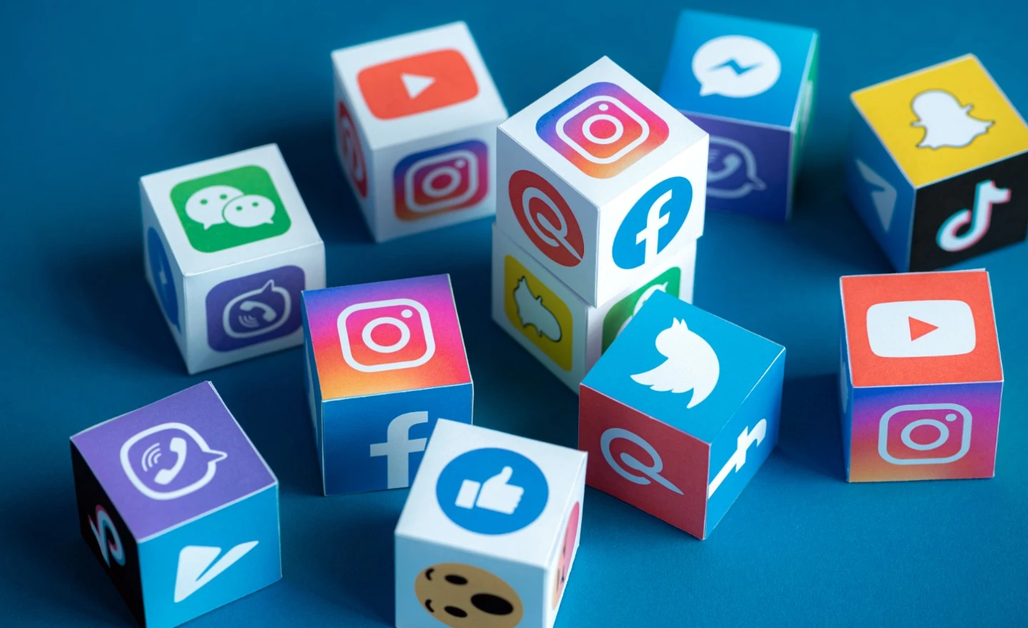
Social media platforms

Slide 6
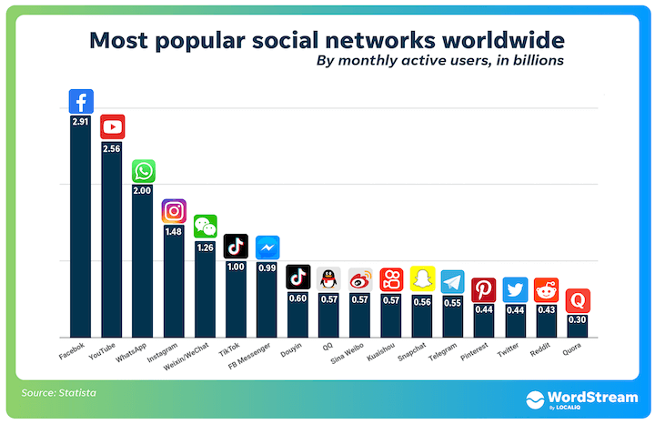

Slide 7

What is social media usage ?
Social media usage is one of the most popular online activities. In 2021, over 4.26 billion people were using social media worldwide, a number projected to increase to almost six billion in 2027.

Slide 8
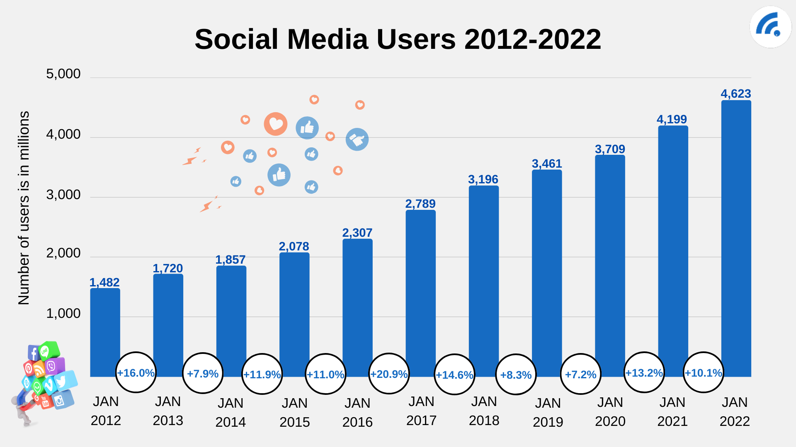

Slide 9

Why social media is rising?
Growth will come primarily from the rapidly expanding online and mobile user bases in emerging markets. Individuals will be highly connected through mobile technology and social media. More than 30 percent of the global population will have the unprecedented capability to connect with anyone.

Slide 10
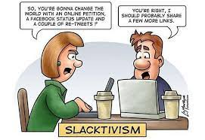

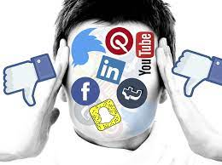

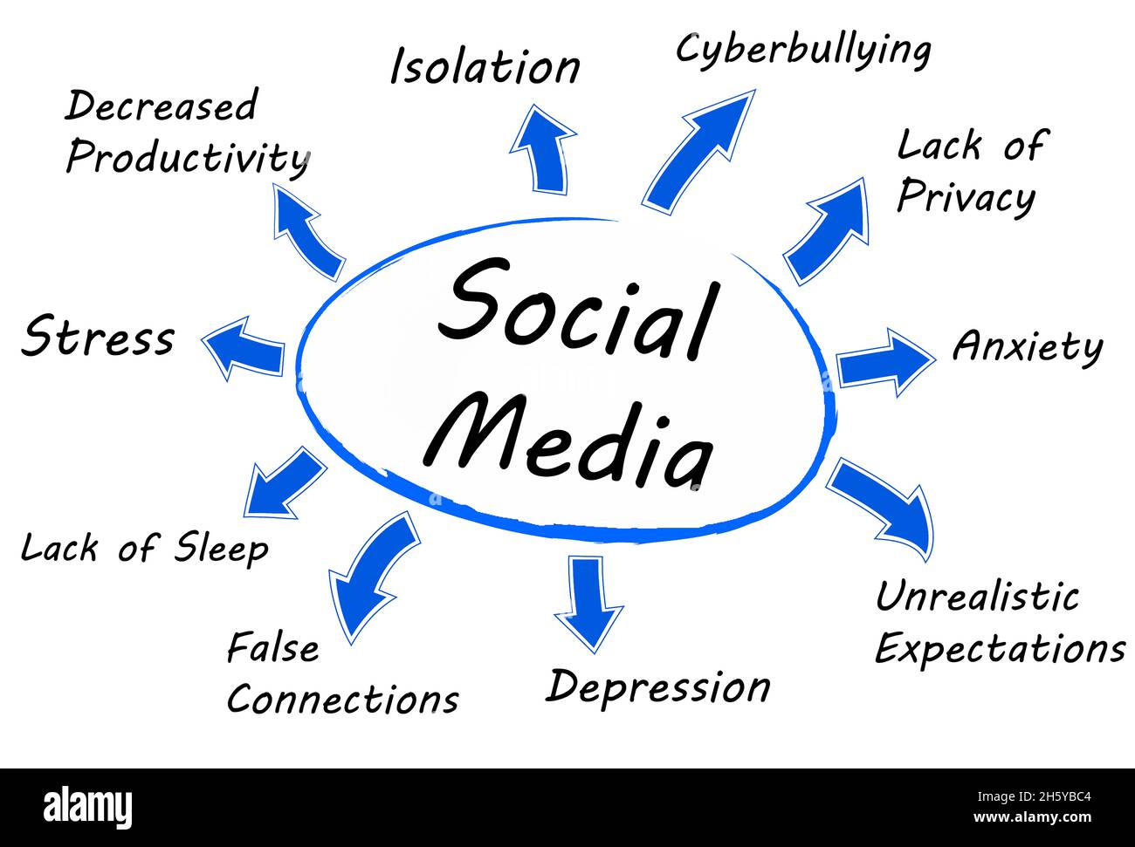
Impact of social media

Slide 11

Any Question?

Slide 12


